Slide 1


Object Oriented
Software Engineering
Lecturer John Andrews

Slide 2

Class diagrams

Slide 3
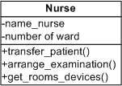
Visibility of attributes & operations
Attributes and operations of a class can be defined in a way that they have different access rights for operations of other classes.
This definition of access rights is also called visibility of attributes and operations.
Visibility relates to the level of information hiding to be enforced for the attribute.

Slide 4
Attributes and Visibility
public (+).
Anyone who sees the class can see the attribute / operation. This is the least limited visibility.
protected (#).
Available within the class in which it was defined, and within any subclass of this class.
private (-).
Only visible within the class. This is the most limited visibility.
package (~).
Attributes or operations that are defined in packages are visible and accessible for all other classes within the same package.

Slide 5
Associations
An association is a relationship between classes that indicates some meaningful and interesting connection.

Slide 6
Finding Associations:
Start compiling associations by using the following list (examples are drawn from the airline reservation domain):
A is a physical part of B e.g. Wing - Aeroplane
A is a logical part of B e.g. FlightLeg - FlightRoute
A is physically contained in/on B e.g. Passenger- Aeroplane
A is logically contained in B e.g: Flight - FlightSchedule
A is a description of B e.g: Flight - FlightDescription
A is a member of B e.g: Pilot - Airline
A is an organizational sub-unit of B: Maintenance - Airline
A uses or manages B e.g: Pilot - Aeroplane
A communicates with B e.g: ReservationAgent - Passenger
A is related to a transaction B e.g: Passenger - Ticket.

Slide 7
Associations & Multiplicity
Name is optional
The Multiplicity is established by asking 3 questions:
Can ONE occurrence of Class A be related to MORE THAN one occurrence of Class B?
Can ONE occurrence of Class B be related to MORE THAN one occurrence of Class A?
Is zero allowed?
1 | No more than one
0..1 | Zero or one
* | Many
0..* | Zero or many
1..* | One or many

Slide 8
Associations & Multiplicity
1 | No more than one
0..1 | Zero or one
* | Many
0..* | Zero or many
1..* | One or many
Company
Attributes
Methods ()
1
1..*
Not all associations are one - to - one relationships.
For example, a person can own zero or more cars.
To express how many, we use multiplicity, a range that tells us how many objects are linked.
The range can be zero-to-one (0…1), zero-to-many ( 0..*), one-to-many (1..*), two (2), five to eleven (5..11) and so on.
Person
Attributes
Methods ()

Slide 9
Generalization & Aggregation
Generalization shows that a subclass inherits from a superclass
Doctors, nurses, admin personnel are kinds of employees
Aggregation classes comprise other classes
Health team class comprised of doctor, nurses, admin personnel classes

Slide 10
Generalisation
Generalisation is the activity of identifying commonality among concepts / classes and defining supertype (general concept) and subtype (specialized concept) relationships
A generalisation is sometimes called an “is-a” relationship
e.g. a car is-a vehicle, a sales-manager is-an employee etc.

Slide 11
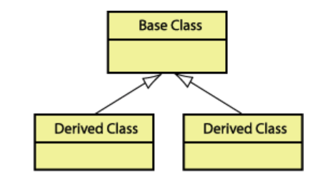
Generalisation
Is object X an object Y?
E.g. Class Person & Class Student
Is a Student a Person?
Indicated with an Arrow
Inheritance:
Subtype inherits attributes of Supertype
E.g. Student inherits attributes of person
Person
Name Address Age
Born() Die() Move()
Student
Major
Register()

Slide 12
Aggregation
Aggregation is a special case of association.
The Aggregate indicates that the relationship is some sort of “whole-part”.
The keywords used to identify aggregates are “consists of”, “contains”, “is part of” etc.
An aggregate is visualized as a line with a hollow diamond (or rhomb) attached to one end of it (the wholeside).
For example, the navy contains many warships:

Slide 13
Whole / Part Aggregations
Is one object part of another whole object?
E.g. Car & Engine
No inheritance implied
Indicated with a diamond on whole end
Order
date status
CalcTax() CalcTotal() CalcWeight()
1
1..*
OrderDetail
quantity taxStatus
CalcSubtotal()

Slide 14
Composition
Composition is a special, stronger, kind of aggregation.
It can be regarded, just like the aggregation, as a relationship between a whole and a part of that whole (whole/part association).
There is, however, an even stronger link between the whole and the part.
In a composition, the part "lives" or "dies" with the whole, i.e. it only exists together with the aggregate or the composition.
Hence, it is part of only one composition.

Slide 15
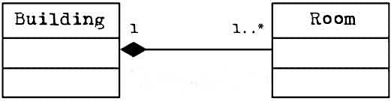
Composition
Notation. The composition is represented as a small filled rhomb attached to the aggregate.
The part instance cannot have relationships with other aggregates, because it belongs exclusively to only one composition.

Slide 16
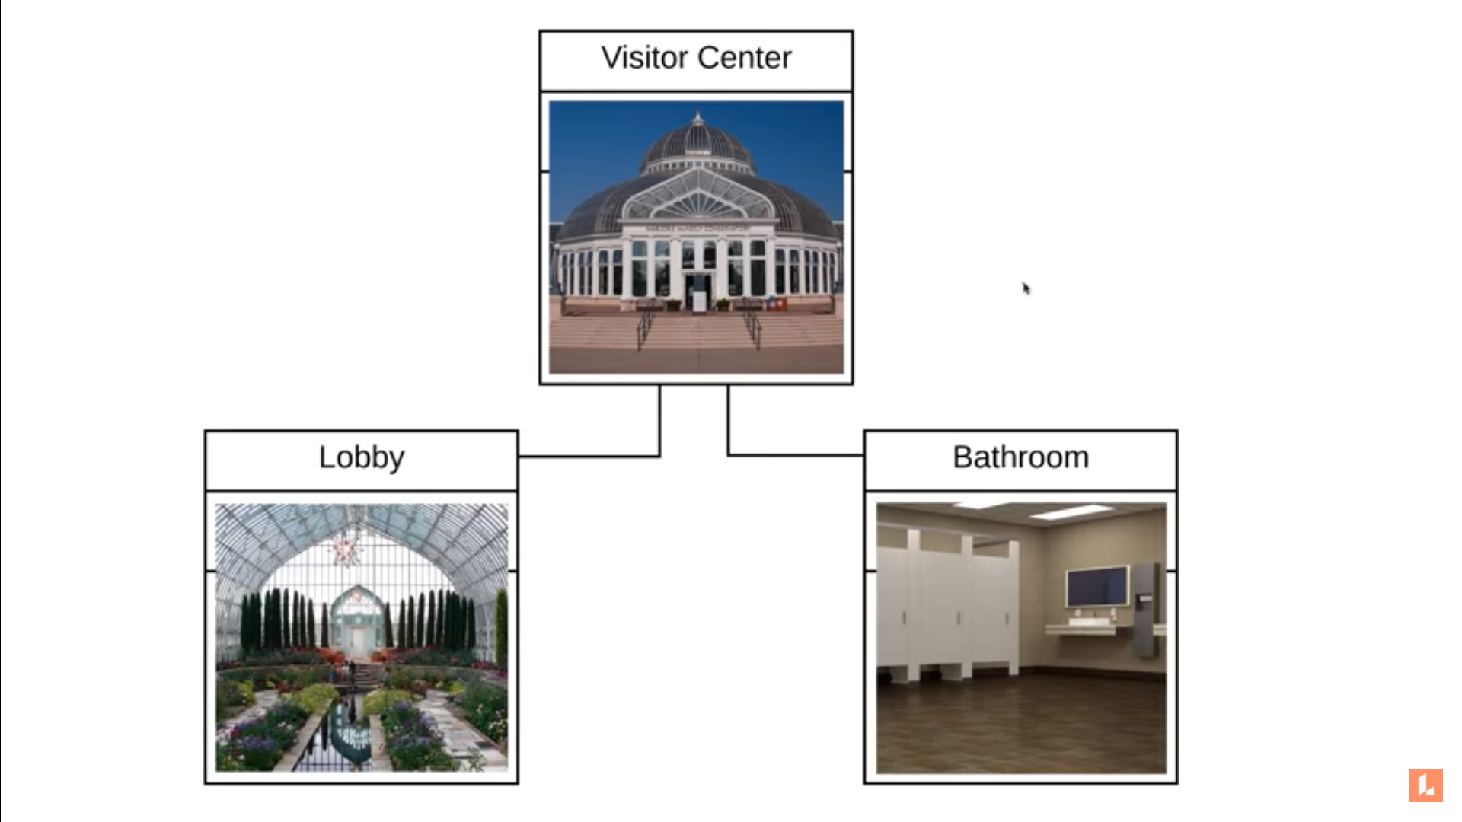
Composition

Slide 17
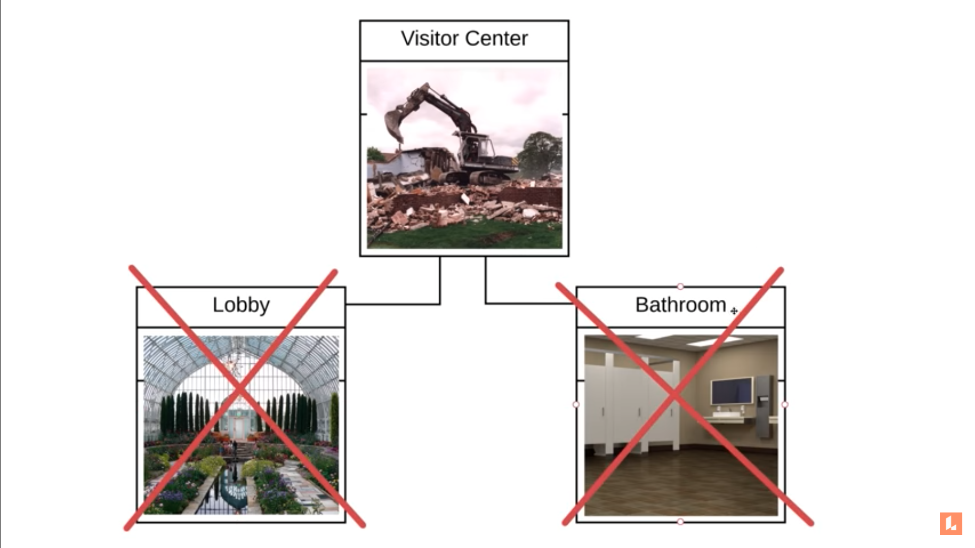
Composition

Slide 18
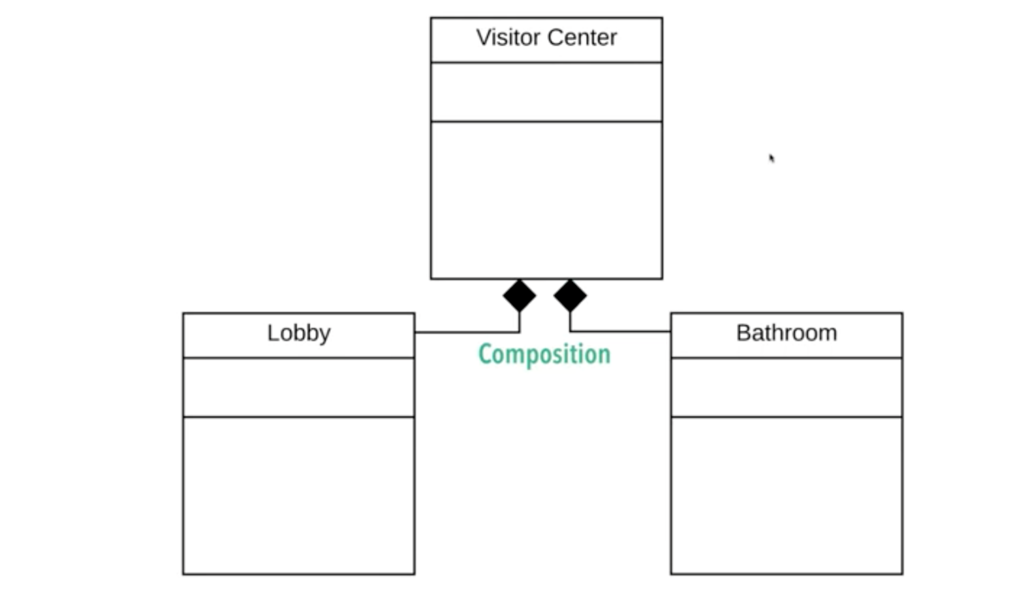
Composition

Slide 19
Association Class
A class can be attached to an association, in which case it is called an association class.
In the example above we need to keep information about the period of time that each employee works for each company.
We do this by adding the employment class to the association.

Slide 20
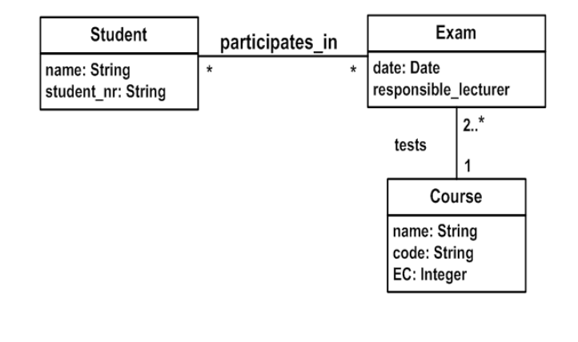
Association Class

Slide 21
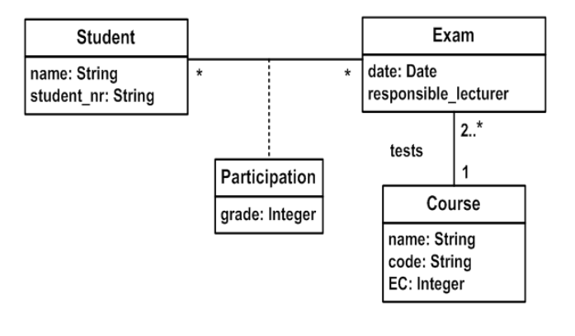
Association Class

Slide 22
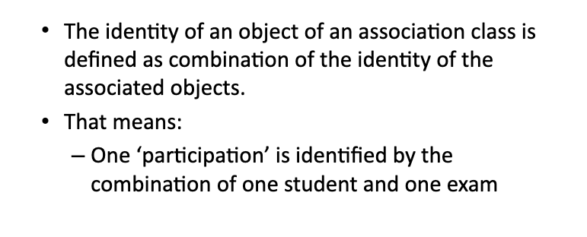
Association Class

Slide 23
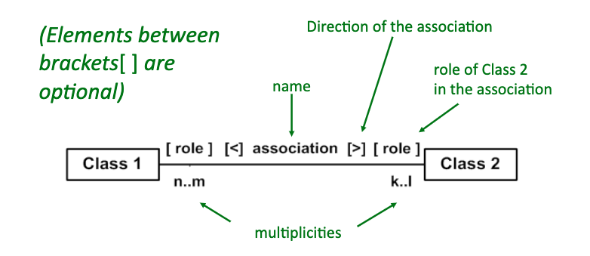
Roles in an Association

Slide 24
Roles in an Association
An association can have roles connected to each class involved in the association
The role name indicates the role played by the class in terms of the association.
Roles are a useful technique for specifying the context of a class with respect to the association.

Slide 25
Thank you!

Slide 26
Constraints
The constrained association is a special kind of association. It is employed for associations which are only used under specific conditions.
Much of what we are doing in drawing a class diagram is indicating constraints.
The basic constructs of association, attribute, and generalization do much to specify important constraints, but they cannot indicate every constraint.
The UML defines no strict syntax for describing constraints other than putting them inside braces.

Slide 27
Packages
Packages are vital in defining the system architecture.

